Slide 1
Victorian Registration and Qualifications Authority
Non-Government Schools
Practical Financial Management
Video presentation
25 May 2022 10am to 11am
As a member of Chartered Accountants Australia and New Zealand Somerset Education participates in a national liability capping scheme. Accordingly our liability is limited by a scheme approved under professional standards legislation.

Slide 2
John Somerset
Analysing schools for 27 years
Qualifications
Master of Business (Research) QUT
Graduate Diploma Company Directors Course
Certificate IV in Workplace Training and Assessment
Graduate Diploma in Applied Finance and Investment
Professional Year Institute of Chartered Accountants
Bachelor of Commerce University of Queensland
Accreditations/Memberships
Graduate - Australian Institute of Company Directors
Fellow - Financial Services Institute of Australasia
Fellow - Chartered Accountants Australia and New Zealand
Core Expertise
Chartered accounting – 36 years
Accounting, taxation, business advisory
Benchmarking and financial analysis of schools (27 years)
Corporate governance of schools
Financial viability and sustainability of schools
Budgeting ,board reporting and analytics
Appointments
Riverside Christian College (2021 - )
St Stephen’s College (2004 - 2020) – 16 years
  Director, Chair Finance, Audit and Compliance
Independent Schools Council of Australia – 7 years
  Director 2011 - 2018
Independent Schools Queensland - 18 years
  Chair 2011 – 2018, Treasurer 2001 - 2011
St Paul’s School Foundation (Chair 2006 to 2008)
St Paul’s School (2000 – 2008) – 8 years
  Council and Finance

Slide 3
Legislation

Slide 4
Legislation Mandates Financial Viability
  Australian Education Act 2013
    Section 75(4) The person is financially viable
  Australian Education Regulations 2013
    Section 27 Financial viability requirement
  Guide to the Australian Education Act 2013
    C.2.4 Financial viability
  State/Territory Education Acts – For Victoria
    Education and Training Reform Act 2006
    Education and Training Reform Regulations 2017
    Guidelines to the Minimum Standards and Requirements for School Registration
    Guidelines – School Financial Capability Assessment
  Corporations Act 2001
    Section 588G Directors duty to prevent insolvent trading
    Regulatory Guide 217 Duty to prevent insolvent trading: Guide for directors
  Australian Charities and NFP Commission
    Governance standard 5: Duties of responsible persons
  Fiduciary duty (position of trust)

Slide 5
Education and Training Reform Act 2006 (authorised version 2 May 2022)
  Section 4.3.1 (6) (b) school must comply with minimum standards
  Section 4.3.1 (6B) requires monitoring and assessment of school’s financial capabilities …….
  Section 4.3.1A Authority may monitor and assess financial capability of registered non-Government schools
  Section 4.3.8A Authority may issue guidelines for monitoring and conducting assessments of financial capabilities….

Slide 6
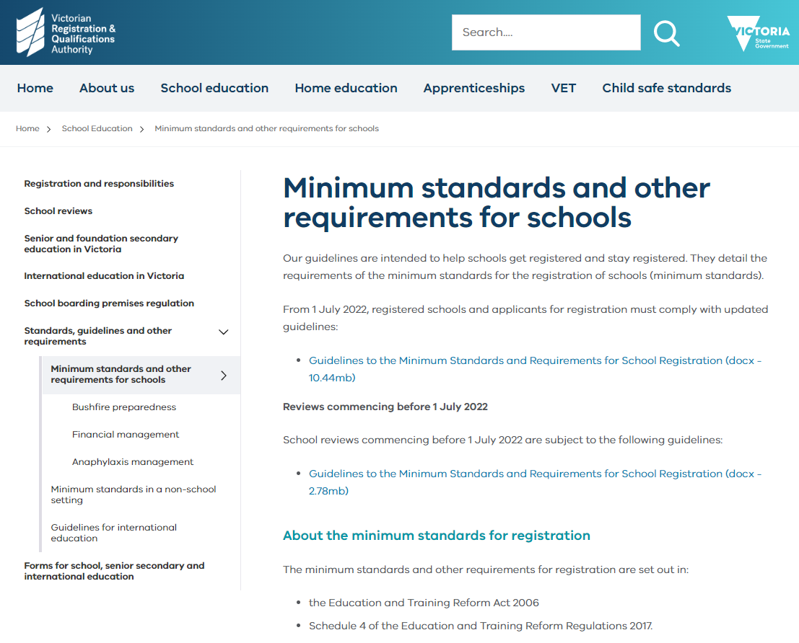

Slide 7

VRQA Guidelines – from 1 July 2022
  Focus today on Governance
  Effective management of finances
  Evidence requirements
    Governance structure and member’s expertise
    Financial and other delegations (who can do what)
    Constitution
    Conflict of interest register (business with related parties)
    Recent financial statements
    Charters, committees (duties, roles, responsibilities)
    Strategic & Business plan
      Enrolment estimates
      SES/DMI (Capacity to pay fees)
      State and Federal funding assumptions
      Adequate facilities
      Five-year budget
      Monitoring and Reporting

Slide 8
Education and Training Reform Regulations 2017 (2 May 2022)
Schedule 4 – Minimum standards for registration
Includes ……
  Minimum of 20 enrolments
    Secondary school must average 10 or more per year level
  Buildings and facilities must be suitable
  Governance must include
    Effective strategic direction
    Effective management of finances
  Must be a not-for-profit (Part 1 - Definitions) includes
    Not established for the purpose of generating a profit or gain
    Profit or gain will not in itself mean the school is “for profit”
    Must apply profit or gain towards the conduct of the school
    Property and assets are not distributed or used for the profit or gain of another person or entity
    Don’t be party to prohibited agreement or arrangement (Regulation 7A) includes
      Purpose is to pay or divert profit or gain to any other person or entity
  VRQA will closely review related party transactions to ensure they are on commercial terms eg
      Contracts
      Loans, guarantees, leases
      Agreements for delivery of services to the school or its students

Slide 9
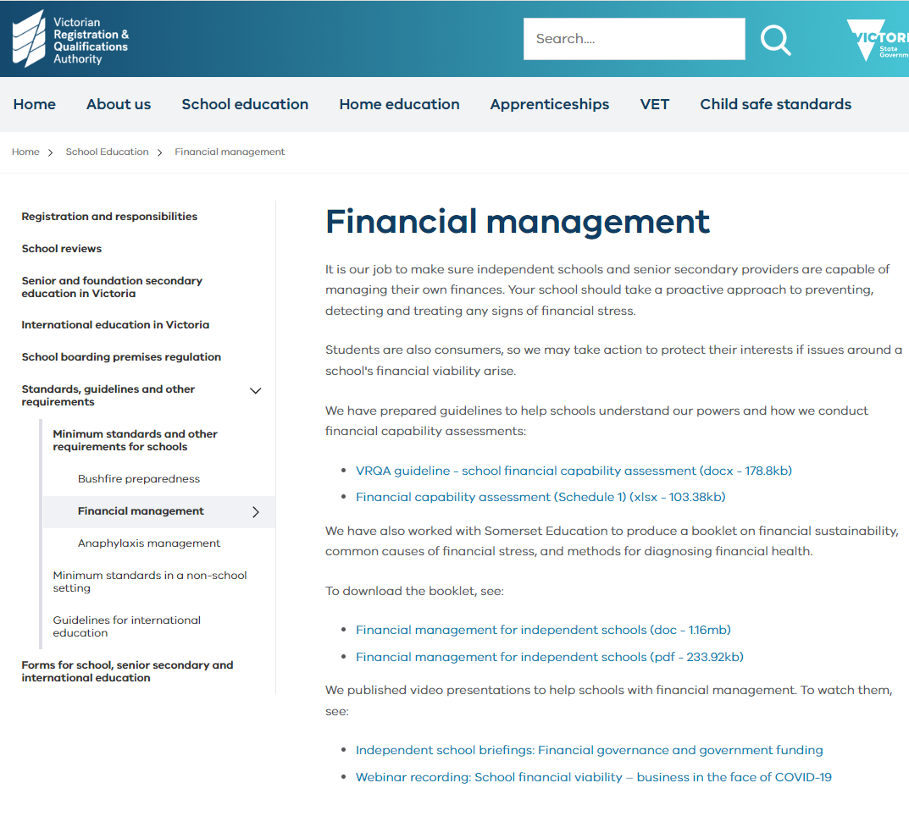

Slide 10
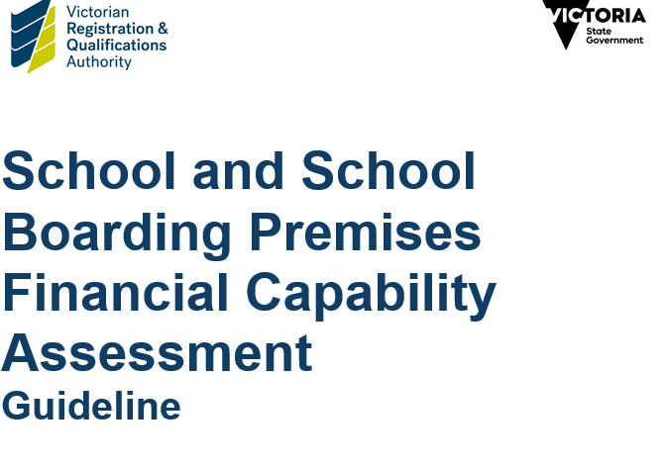
The VRQA may also assess the financial capability of a registered school
VRQA conduct periodic financial capability assessments
Governance of a school must be structured to enable the effective development of the strategic direction of the school, effective management of the school’s finances and fulfilment of its legal obligations
…… has in place strong governance and financial management, underpinned by arrangements where the governing body prepares and updates its business plan and annual budget, and monitors its financial position
……. should cover income and expenditure, balance sheet, cash flow and debtors and creditors, to be considered at each meeting

Slide 11
VRQA School Financial Capability Self Assessment tool
Information requested could include
  List of members and board/directors including qualifications and experience
  Details of related party transactions
  Enrolment, fee, grant details including demographics
  Insurance and legal matters
  Audited financial statements
  Past and current management accounts and working papers (bank reconciliations, debtors, creditors)
  Copies of ATO client accounts
  Copies of finance reports provided to the board
  Strategic and business plan
  5 year budgets
  Loan details and facility limits
  VRQA may engage a contractor to prepare a financial viability assessment report

Slide 12
Sustainability research

Slide 13

Evolving Themes re School Financial Sustainability
(no particular order)
Financial (trend and comparative)
  Operating surplus (profitability)
  Cash reserves (buffer against financial shock)
  Debt and debt servicing
  Facilities (replacement/depreciation)
  Revenue diversification
  Staff and operating expenses – potential for savings
Non-financial
  Enrolment - numbers and fee affordability
  Outcomes - academic, discipline, resilience, wellbeing
  Culture of board and staff - ability to adapt, engaging with parents
Leadership
  Strategy development, sharing and measurement
  Skill mix of board & management + financial literacy
  Stakeholder management- parent, government, banks etc
  Budgeting, accounting, reporting
    Multi-year budgeting
    Timely and accurate
Somerset Financial Survey for Schools analyses this
Ultimately sustainability requires
financial capacity

Slide 14
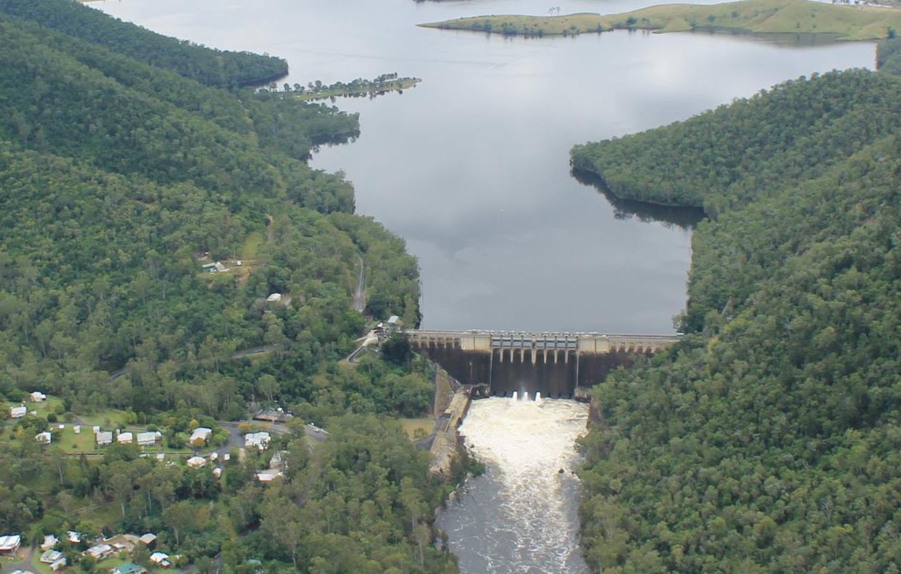
School is a reservoir of cash assets
Surplus
Surplus
Surplus
Surplus fills the reservoir
Reinvest
Debt
Drains the reservoir

Slide 15
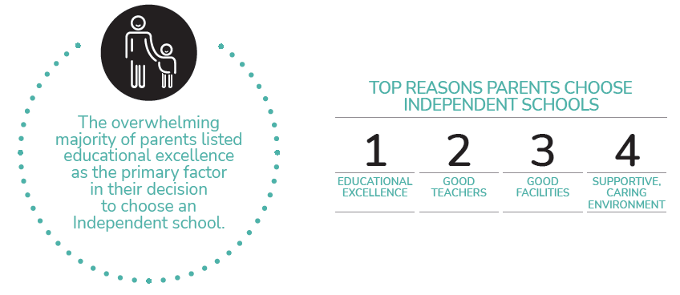
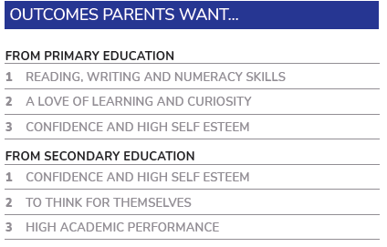
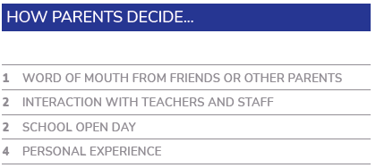
Why Parents Choose Independent Schools
Independent Schools Australia, revised 2021(collections started in 2006)
Independent Schools Queensland
What Parents Want survey 2021
70% parents said their decision based/highly influenced by facilities
53% said choice totally or highly influenced by child’s opinion
Parents value meeting with

Slide 16
The language of Money

Slide 17
The language of Money
Story of financial information – told in dollars
Same for 500 years (Luca Pacioli)
A representation of the story – not necessarily the actual story
Different ways to tell the story (don’t be fooled)
  Cost -v- Market value
  Cash -v- Accrual
Summarises raw data into a logical format
Fiduciary Responsibility
Data
Information
Informed Decisions

Slide 18
Communicating Financial Information
Most common reports
  Statement of Profit and Loss and other Comprehensive Income or Income Statement or Profit & Loss (same thing!)
  Statement of Financial Position (Balance sheet)
  Statement of Cash Flows (removes non-cash accounting adjustments)

Slide 19
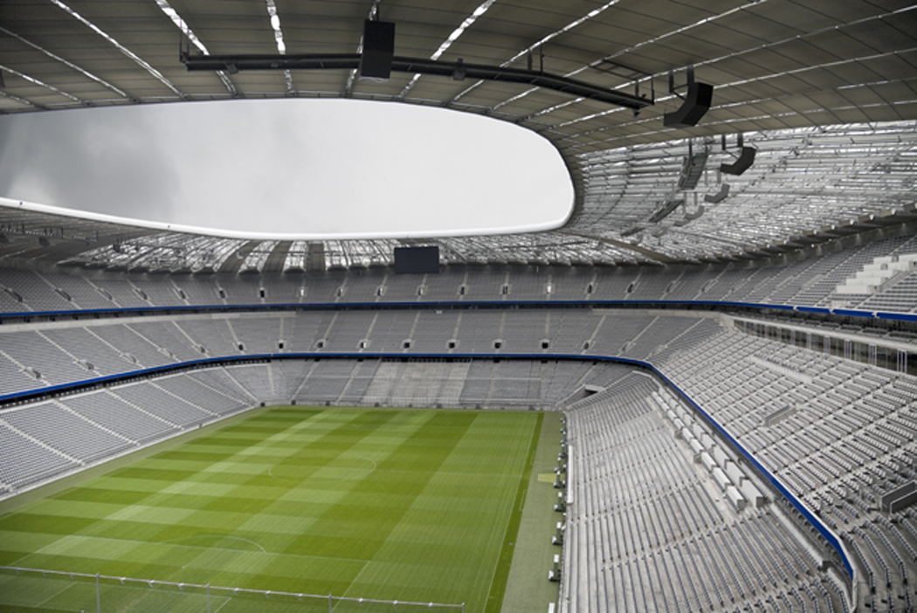
The Players on the Field
Statement of Financial Position
Your World
Statement of Comprehensive Income
Playing the game with the outside World

Slide 20
Statement of Financial Position - Your World
A “picture” at a point in time.
What you Own Assets
Less -
What you Owe Liabilities (debts)
Equals =
What you are Worth Equity (Retained Earnings)
Income Statement - Where you play the game with the World

Slide 21
Financial Position – A “picture” at a point in time
Current Assets = Cash or things convertible to cash within 12 months
Non-Current Assets = Other things you own that will take longer than 12 months to convert to cash
Current Liabilities = Debts due within 12 months
Non-Current Liabilities = Debts with longer than 12 months to pay

Slide 22
Financial Position - Your World
A “picture” at a point in time.
What you Own Assets
Less -
What you Owe Liabilities (debts)
Equals =
What you are Worth Equity (Retained Earnings)
Income Statement - Where you play the game with the World
An explanation of what happened over time
Income Inflow of economic benefits (Fees, grants, other)
Less
Expenses Costs incurred in operating the school
Equals
Net Operating surplus
(Profit) Net inflow or outflow of wealth

Slide 23
Recurrent -V- Capital Income and Expenses
Two classifications
Recurrent
  Income regular/annual spent during the year eg.
    Tuition fees and grants
    Bookshop sales
  Expenses regular/annual spent during the year. Generally can’t see and touch the outcome eg.
    Staff salaries
    Telephone
    Maintenance
Inflow of wealth
Outflow of wealth

Slide 24
Recurrent -V- Capital Income and Expenses
Capital (long term benefit or one-off)
  Income not regular/annual eg.
    Grants for buildings
    Donation to Foundation Scholarship Fund
    Other income which you don’t expect to receive each year
  Expenses not regular/annual and have an enduring (long-term) benefit. Generally see and touch the outcome eg.
    Building a new science block
    Purchase computers
Inflow of wealth
Outflow of cash
Get something
tangible in Return
Inflow of an asset

Slide 25
The “Aim” of the Game
Earn more than you spend
Own more than you owe

Slide 26
The “Aim” of the Game
Financial Position
Financial Performance
The Outside World
Your School
Entity
(Internal World)
Income $1,000
Adds to wealth
Expenses $900
Take away wealth

Slide 27
The value of the entity grows by $100
Financial Position
Financial Performance
The Outside World
Extra $100 Cash
Internal World Grows
Income $1,000
Adds to wealth
Expenses $900
Take away wealth

Slide 28
Reinvest $100 on a building
Financial Position
Just a flow of cash. No change in wealth. Just A reallocation of assets from cash to building
The Outside World
Extra $100 Cash
Building worth $100
(Entity did not grow)
Building supplied
Builder paid $100

Slide 29
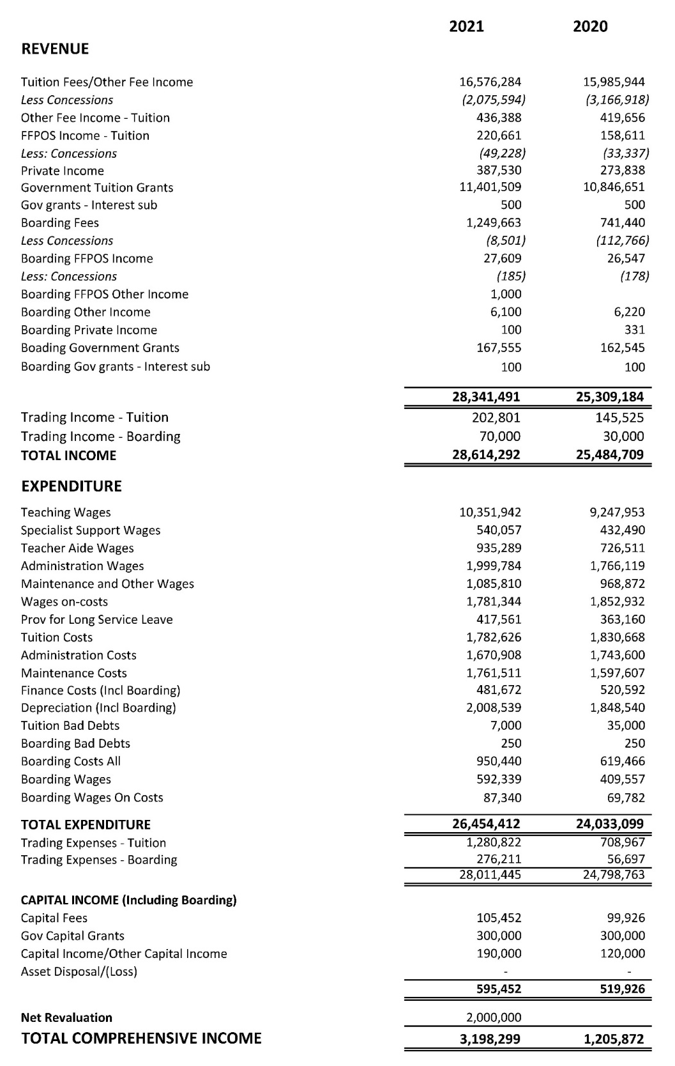
Somerset Example School
Profit and Loss and other comprehensive income

Slide 30
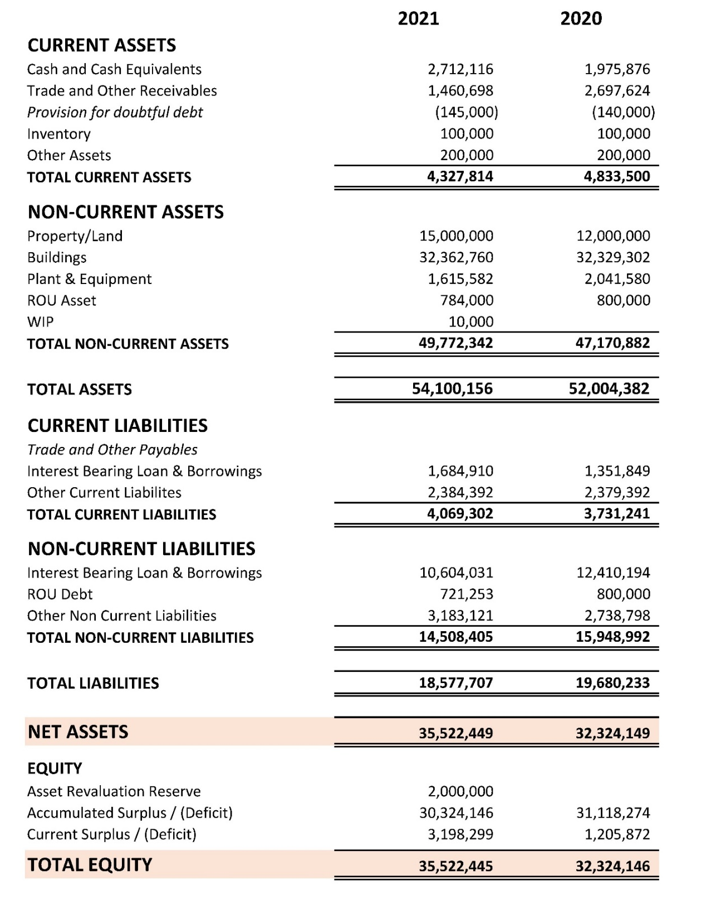
Somerset Example School
Statement of Financial Position

Slide 31
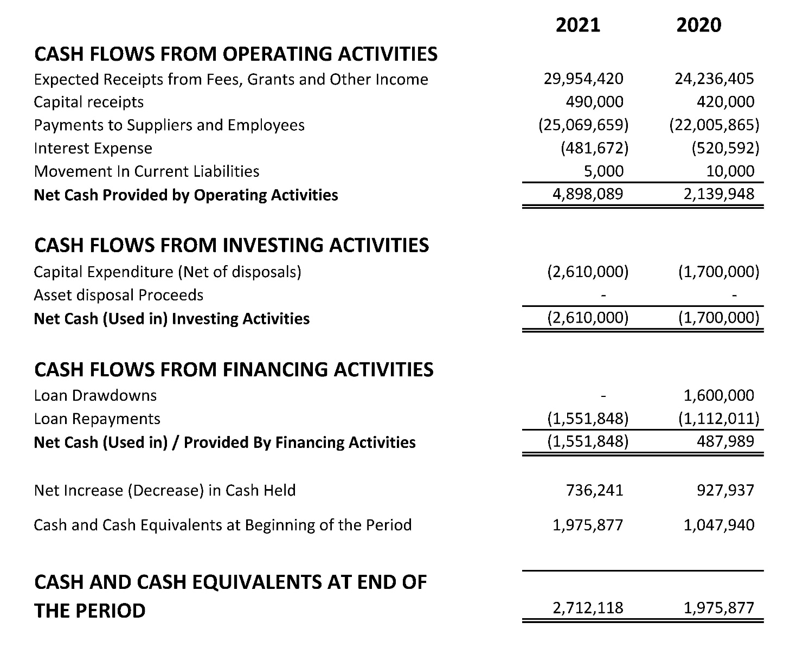
Somerset Example School
Statement of Cash Flows
Fill reservoir
Drain reservoir
Fill reservoir with net borrowings
Drain reservoir
Reservoir growing

Slide 32
Simple and Clear analysis
using
Financial Survey for Schools
www.somerseteducation.net/survey

Slide 33

Benchmarks – A Point of Reference
Help INFORM decisions
A reference point or hurdle
What is a reasonable
  Operating surplus (profit)?
  Cash reserves
  Debt?
  Staff number?
Benchmarks are our guiding tracks

Slide 34
Use Ratios and benchmarks to
Assess Financial Health
  Trend in your ratios (past 5 years & future 5 years)
  Plus compare with similar schools
Identify changing circumstances
Quantify strengths & weaknesses
Raise appropriate questions
Respond with informed decision

Slide 35
Important Financial Goals and Questions
Make a surplus (profit) with the outside World
  Question 1 Are we Profitable?
Be able to pay debts when due
  Question 2 Are we solvent/viable
Grow asset base and service debt
  Question 3 Are we sustainable? (multiple periods of viability)

Slide 36
Profitability
This fills the reservoir

Slide 37
Calculation of Net Operating Margin - example
Recurrent operating surplus
(before interest expense) $1 million
Gross income from fees grants and other income $10 million
= Net operating Margin 10%

Slide 38
Example School 2020
Net Operating Margin – page 15 Comparative Report
This indicates your operating surplus was $700,000 less than average school in the sample with similar turnover.

Slide 39
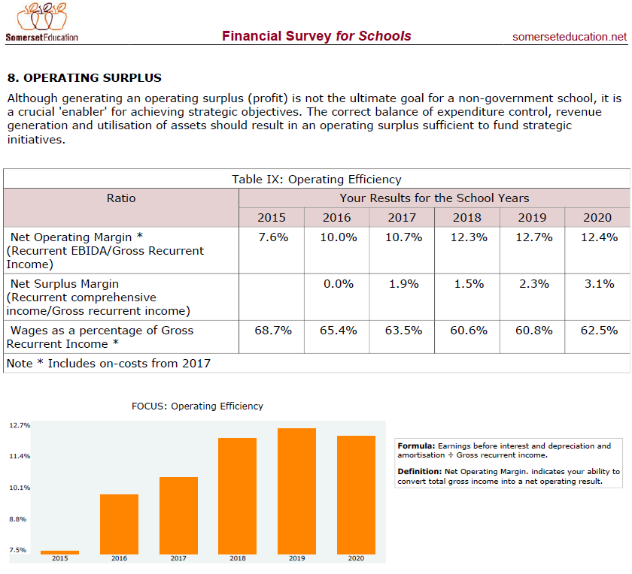
Example School
Net Operating Margin trend – page 12 Historical Report

Slide 40
Example School 2020
Income per student – page 10 Comparative Report
Your income is $400,000 less than average.
Note income sources – indicates a reasonable sample
Debtors and discounts higher than average. Is a fee affordability issue emerging?

Slide 41
Example School 2020
Expenditure – page 12 Comparative Report
Your expenses are $400,000 higher than average
Major areas
  Teaching Resources + $650,000
  Administration salaries and expenses + $440,000
  Maintenance + $200,000
Teaching salaries relatively low
How does this correlate to staffing?

Slide 42
Student/Teacher ratio
Number of students
Full-Time teacher equivalent
= Average number of students per FTE teacher
Best Practice = Depends on the school
Nationally
Wages = 80% of total expenses
Teacher wages = 58% of total expenses

Slide 43
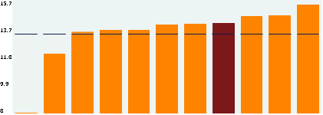
Example School 2020
Primary Staff ratios – page 14 Comparative Report
(2.1)
Primary student/teacher ratio
2.1 fewer primary school staff as average school with same enrolments
Exclude maintenance staff because this is influenced by your choice to employ or outsource and also the relative size of properties to be maintained.

Slide 44
Example School 2020
Secondary Staff ratios – page 14 Comparative Report
+ 4.2
Secondary student/teacher ratio
4.2 more Secondary staff than average school with same enrolments
Apart from administration, doesn’t quite align with costs. Indicates lower cost per staff member
Should the school budget for wage rate increases in the near future?
Exclude maintenance staff because this is influenced by your choice to employ or outsource and also the relative size of properties to be maintained.

Slide 45
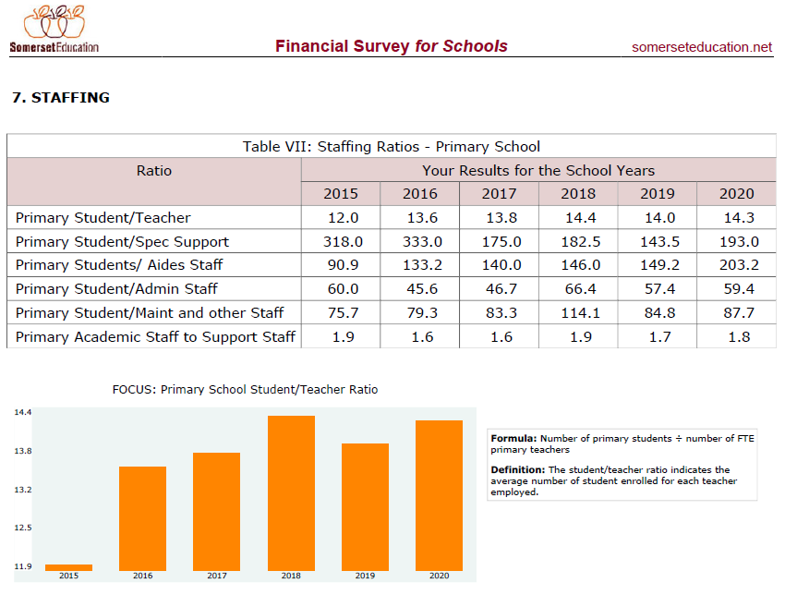
Example School
Primary staff ratio trends – page 10 Historical Report

Slide 46
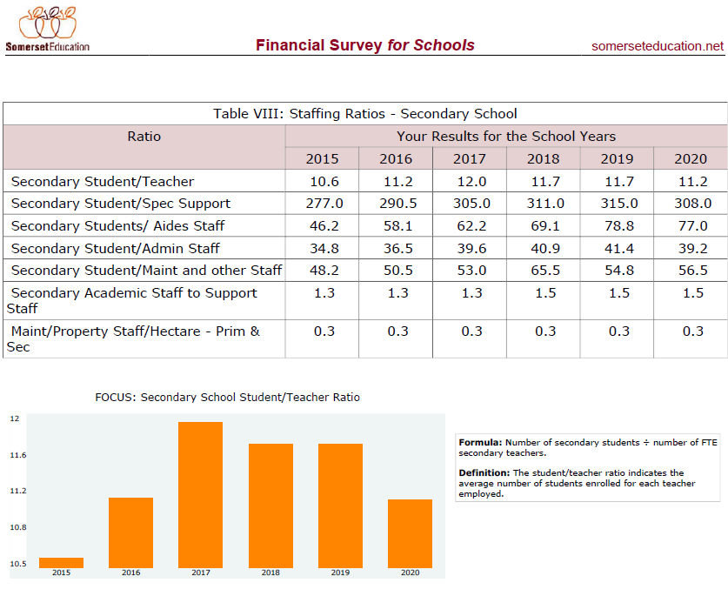
Example School
Secondary staff ratio trends – page 11 Historical Report

Slide 47
Example School
Net Operating Margin trend – page 12 Historical Report

Slide 48
Solvency
Ability to pay debts when due

Slide 49
Working Capital Ratio
= Current assets
Current liabilities
= For every dollar of debt due in the next 12 months (denominator), how much cash (numerator) was available?
Rule of thumb = at least 1 times
Australian Independent schools national average 1.3 (2020 school year)
Increasing trend over recent years

Slide 50
Cash Reserves
(measured in months of operating expenditure)
Research indicates 1 - 3 month’s of operating expenses in cash reserves.
Our operating expenses = $24 million /Annum
= $2.0 million/month

Slide 51
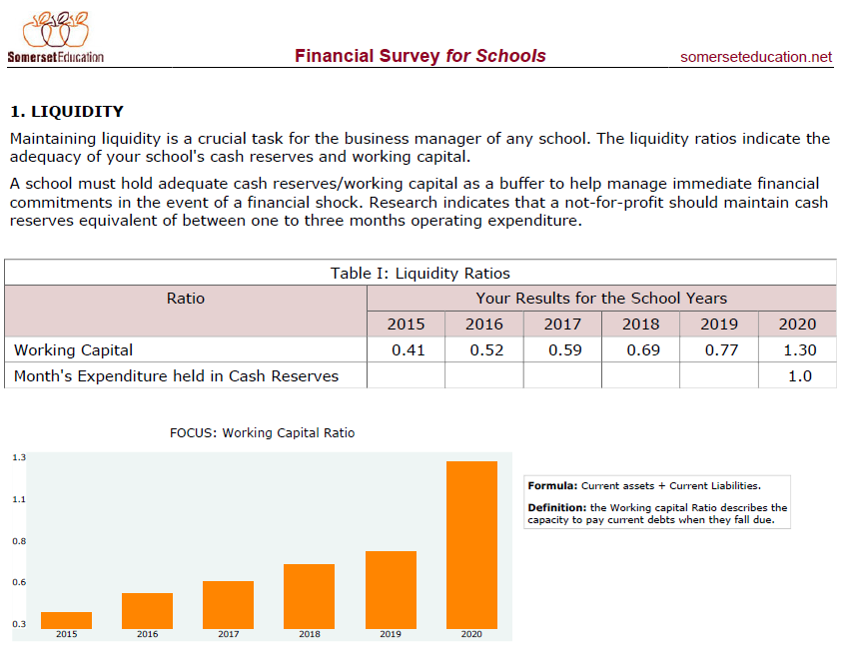
Example School
Liquidity trends - page 3 of the Historical Report
New this year

Slide 52
Sustainability
This draws from the reservoir

Slide 53
Debt per student
(excluding right of use)
Interest bearing (bank) debt
Student numbers
Sample Average about $9,511 (2020 school year)
Independent schools Australian national average about $8,400 (2020)
Debt excluding right of use “debt”
Student numbers
New this year

Slide 54
Debt Servicing Cover
Earnings before interest, depreciation, amortisation
Interest expense + Principal repayments
= Number of times the school can meet its principal and interest payments
Rule of thumb > 1.5 times

Slide 55
Debt / EBIDA
Total Debt
Earnings before interest, depreciation, amortisation
= How many years of EBIDA to repay debt
Rule of thumb debt should be less than 4 times EBIDA
New this year

Slide 56
Example School 2020
Debt Ratios – page 9 Comparative Report

Slide 57
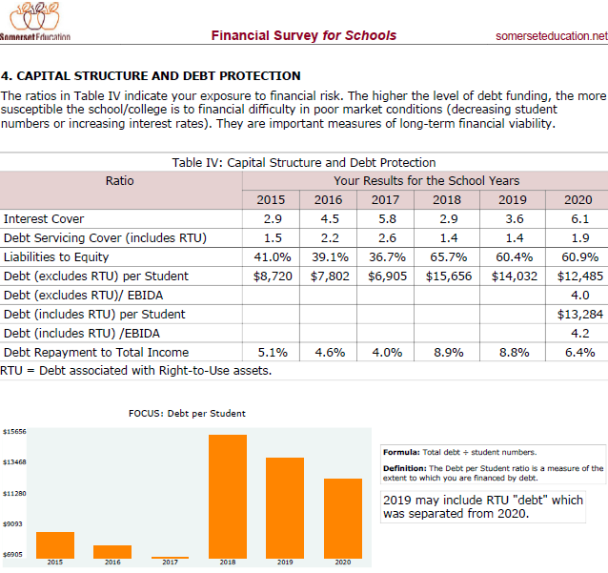
Example School
Debt ratios trend – page 6 Historical Report
New this year

Slide 58
Depreciation Impact
Depreciation expenditure
Net cash from operations
Depreciation is proxy for asset replacement needs
Indicates % of the operating surplus to be directed to asset replacement.

Slide 59
Reinvestment ratio
Capital expenditure
Net cash from operations
Indicates % of operating surplus actually reinvested into asset replacement.

Slide 60
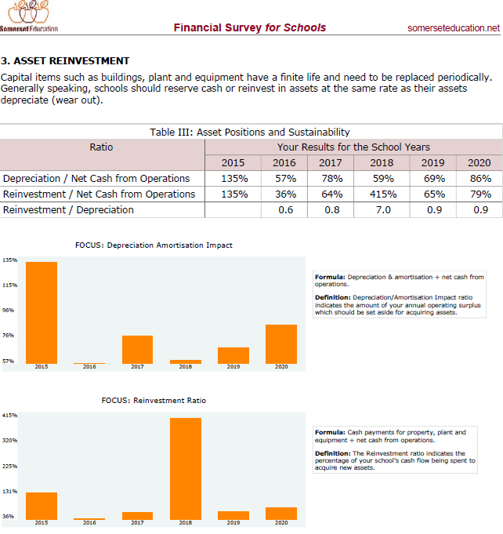
Example School
Asset reinvestment ratios trend – page 5 Historical Report

Slide 61
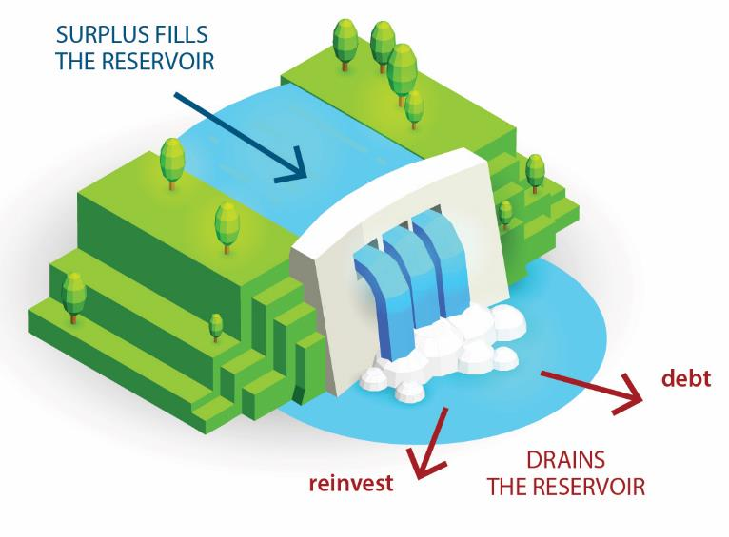
Somerset Example School Sustainability – 2020
12.4% Net Operating Margin
Regular Cash Inflow $1.7 million (plus capital income of $420,000)
?
Minimum debt repayment $1.1 million
Minimum reinvestment $1.8 million
(Depreciation as a proxy)

Slide 62
Example School indications
Enrolments trending up and stable
Improved trend in operating surplus (margin) but reduced in 2020
2020 Income $420,000 less than average
High discounts and outstanding fees. Growing affordability issue?
2020 Expenses $400,000 above average
  Teaching Resources + $650,000
  Administration salaries and expenses + $440,000
  Maintenance + $200,000
Staff numbers more than average but not reflected in costs
  Possible wage adjustment coming
Cash reserves improved
Debt reducing and boarderline serviceability
Catching up on reinvestment but depreciation now > 80% surplus!
Question ability to sustainably fund asset replacement and debt servicing
Use 2019 to 2025 SKI analysis to help assess sustainability

Slide 63
Budgeting and Reporting

Slide 64
Budgets must reconcile
Income Statement
Statement of Financial Position
Statement of Cash Flow
Must Reconcile with each other
Loan Balances
Cash at Bank

Slide 65
Survey to identify efficiencies
Use standard
Chart of Accounts and
FQ item numbers
“Dollarise” strategy into 10 year budget
Income and expenditure
Cash flow
Financial Position
KPIs
Scenarios
What if change in
Enrolments
Teachers
Fees
Grants
Salaries
Other expenses
Recalculates
Operating surplus
Cash at bank
Key ratios
All in the one model
“Dollarise” into 12 month budget
Income and expenditure
Cash flow
Financial Position
KPIs
1 Page Report
Actual
Budget
Forecast
Auto upload
Respond
Identify changes and respond in timely manner

Slide 66
Strategic Budget – at least 5 years into the future
“Dollarise” resources
  Student numbers
  Staffing numbers
  Buildings
  Loans
“3 way” budget
  Financial performance (profit and loss)
  Financial Position (balance sheet)
  Cash flow
Compare KPI’s against benchmarks and policies
Consider trends in key ratios
Notes:
Show the 10 year strategic model in EXCEL at this point. Bring it up on screen and work through its features.
The 10 year model basically dollarises the strategic decisions made at board level.
Discuss each and run through an example.
Make sure all is consistent with strategy.
Not uncommon for me to ask a school board what numbers they expect/want to be in 5 years – they can’t answer.
Crucial question effects resources and borrowing. Ability to service borrowings (profitability) then becomes crucial.

Slide 70
Somerset Key Indicator (SKI) Report
Learn from the Past
Understand the Present
Risk assess the Future
Trend and comparative
analysis

Slide 71
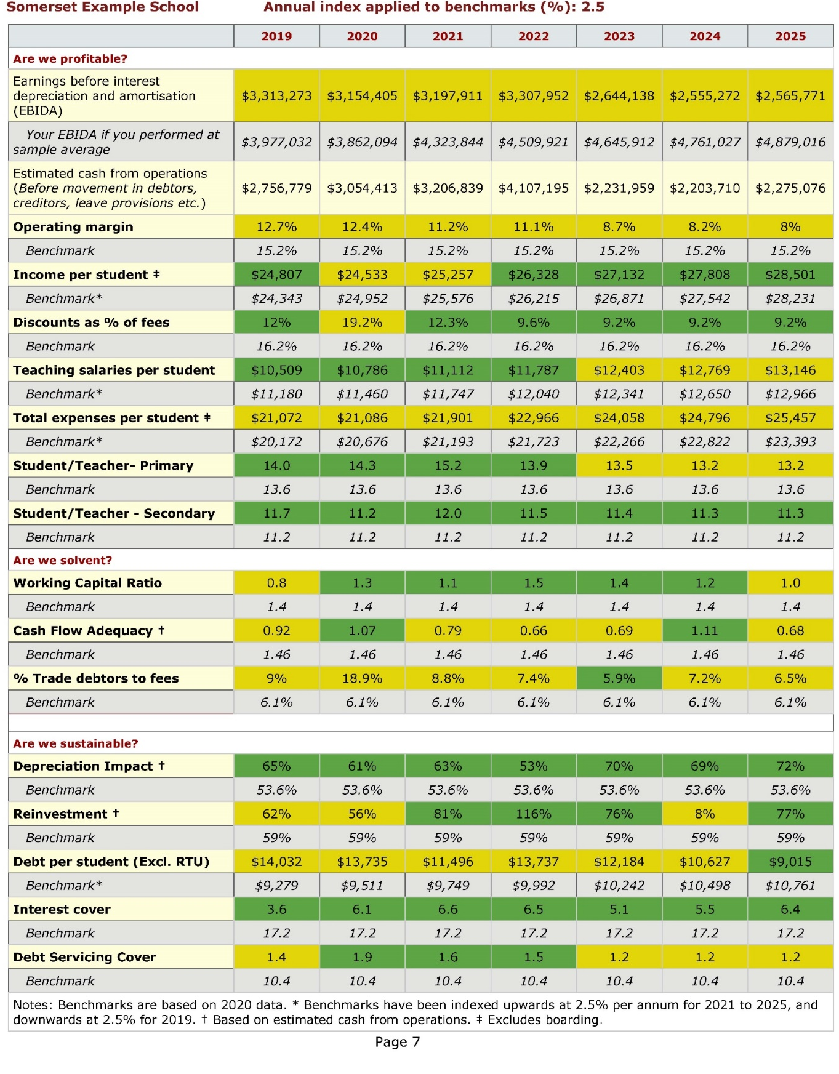
Up to Seven years on one page
Your ratio
Sample av.
Green = OK
Yellow = caution

Slide 72
Scenario SKI Coming soon

Slide 73
Best Practice Reporting
Break down budget by month
  Enrolments
  Staff
  Income and expenditure
  Debtors, creditors
  Capital expenditure
  Cash at bank
  Loans
  Key ratios
Monitor actual verses budget on a monthly/quarterly basis
Respond to variations in a timely manner

Slide 74
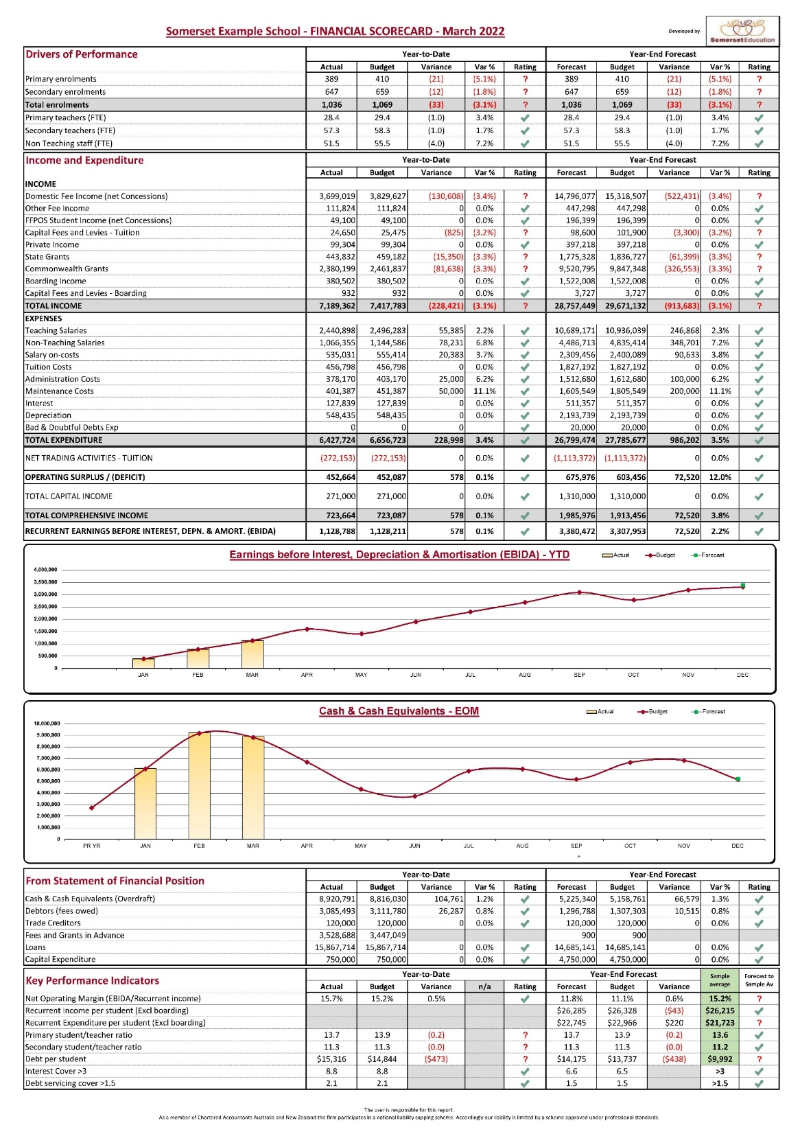

Slide 75
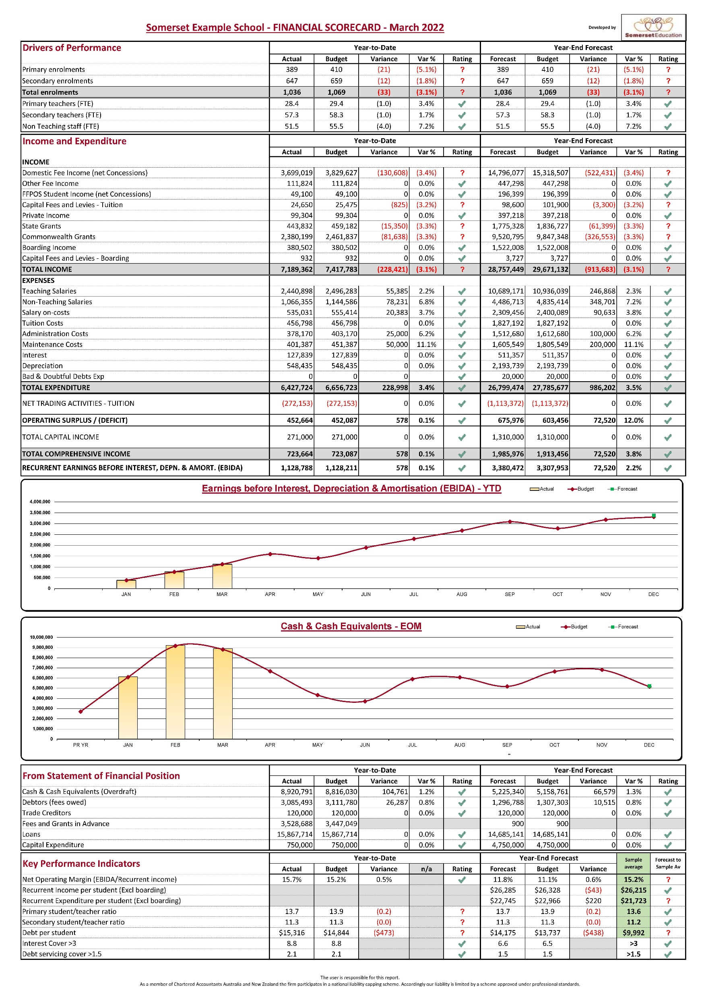

Slide 76
Budget
Actual
Actual
Budget

Slide 77
Case study – benchmarking works
Started re using ratios and benchmarks
Stopped using ratios and benchmarks
Started using ratios and benchmarks

Slide 78
Financial Risk Assessment and Mitigation Policy
  Non-financial factors drive the financial outcomes
  Policy re Net Operating Margin (National 5-year average 13%)
      Operating surplus sufficient to meet debt servicing + asset replacement
  Policy re cash reserves (1 – 3 month’s expenditure)
  Policy re debt (2020 Industry average about $8,400/student)
      Best if loan facility is more than you need
      Debt servicing cover > 1.5 times
      Debt / EBIDA < 4.0
  Understand enrolment trends and drivers
      Demographics (available and ability to pay fees)
      Outcomes - academic, wellness, self esteem
  Policy re staff ratios (80% of operating expenses)
  Positive and innovative (adaptable) culture of staff and board
  Asset reinvestment > Depreciation on average
  Good quality board, management and staff (including financial literacy)
  Build strategic budget (5 – 10 years) with scenarios
  Accurate and timely budgeting, accounting and reporting
  Timely adaption to changed circumstances

Slide 79
Summary
Legal requirement for financial viability
Diverse mix of attributes of a financially sustainable school
Develop a strategy, allocate finite resources, dollarize and analyse
Accounting tells a financial story. All Board members and Principal need enough financial knowledge to confidently ask the right questions.
Trend and comparative ratio analysis to identify changing risk and inform responses
Set targets/Policies for major ratios and metrics
Build 5 – 10 year budget to assess risk
Accurate and timely monitoring (early warning system)
Timely adaption to changing circumstances
Regular training of board and management on the above

Slide 80
Definition of a Financially Sustainable School
(Somerset, 2017)
“A financially sustainable independent school responds to stakeholder needs by using strengths, managing weaknesses, generating adequate operating surpluses to fund debt, reinvestment and cash reserves, identifies changing circumstances and adapts in a timely manner.”

Slide 81
School is a reservoir of cash assets
Surplus
Surplus
Surplus
Surplus fills the reservoir
Reinvest
Debt
Drains the reservoir

Slide 82
For further details contact
John Somerset – Director of Somerset Education
Email john@somerseteducation.net
Internet www.somerseteducation.net
Telephones 1300 781 968 (Australia)
+61 7 3263 5300 (International)
0417 618 899 (Cell phone)
Address GPO Box 3273
Brisbane, Queensland
Australia 4001

